Slide 1
Operating Systems
Memory management PART2
Non-Contiguous Memory management scheme
Paging and Segmentation
1

Slide 2
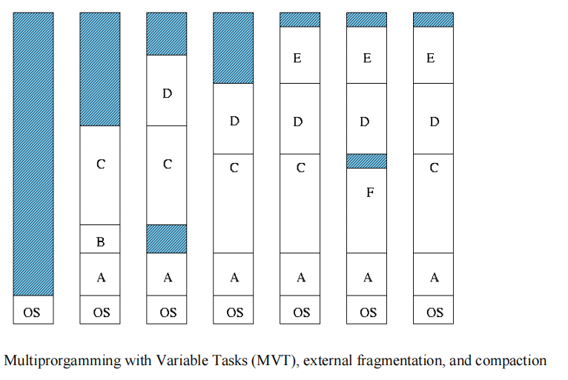

Slide 3
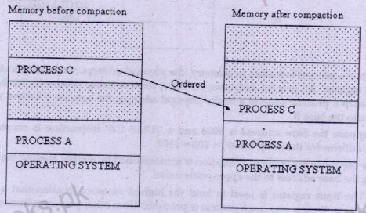

Slide 4
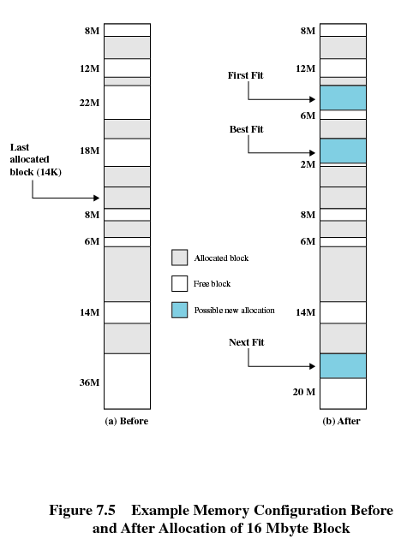

Slide 5
Overview
Paging
Page Tables
TLB
Hierarchical Pages
Hashed Pages
Inverted Pages
Segmentation
2

Slide 6
Address Translation Scheme
Address generated by CPU is divided into:
  Page number (p) – used as an index into a page table which contains base address of each page in physical memory
  Page offset (d) – combined with base address to define the physical memory address that is sent to the memory unit
page number | page offset
p | d
m -n
n
For given logical address space 2^{m} and page size 2^{n}

Slide 7
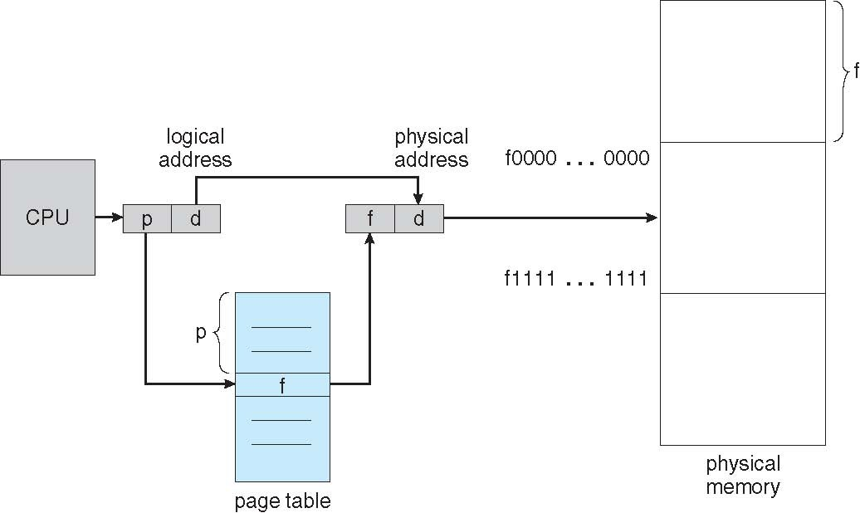
Paging Hardware

Slide 8
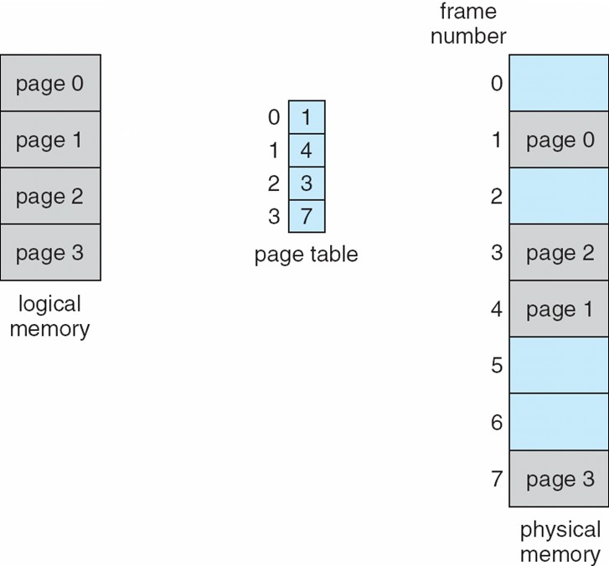
Paging Model of Logical and Physical Memory

Slide 9
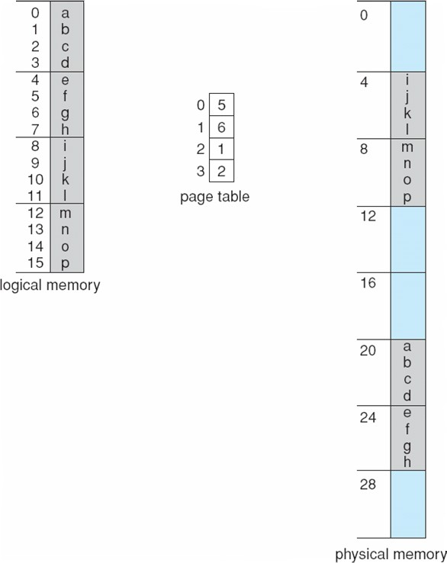
Paging Example
n=2 and m=4
32-byte memory and 4-byte pages

Slide 10
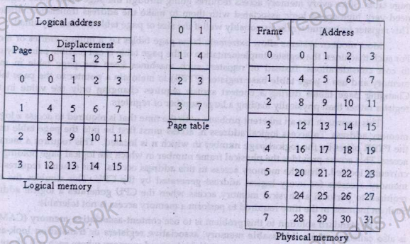

Slide 11
Paging (Cont.)
Calculating internal fragmentation
  Page size = 2,048 bytes
  Process size = 72,766 bytes
  35 pages + 1,086 bytes
  Internal fragmentation of 2,048 - 1,086 = 962 bytes
  Worst case fragmentation = 1 frame – 1 byte
  On average fragmentation = 1 / 2 frame size
  So small frame sizes desirable?
  But each page table entry takes memory to track
  Page sizes growing over time
    Solaris supports two page sizes – 8 KB and 4 MB
Process view and physical memory now very different
By implementation process can only access its own memory

Slide 12
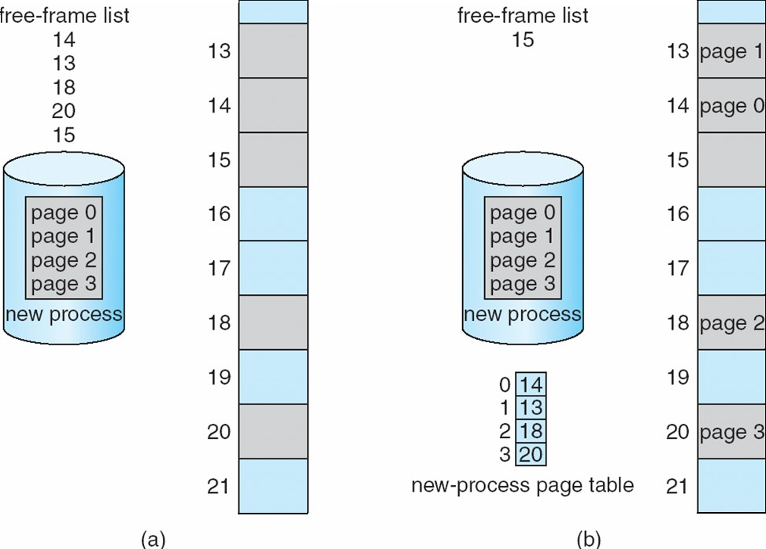
Free Frames
Before allocation
After allocation

Slide 13
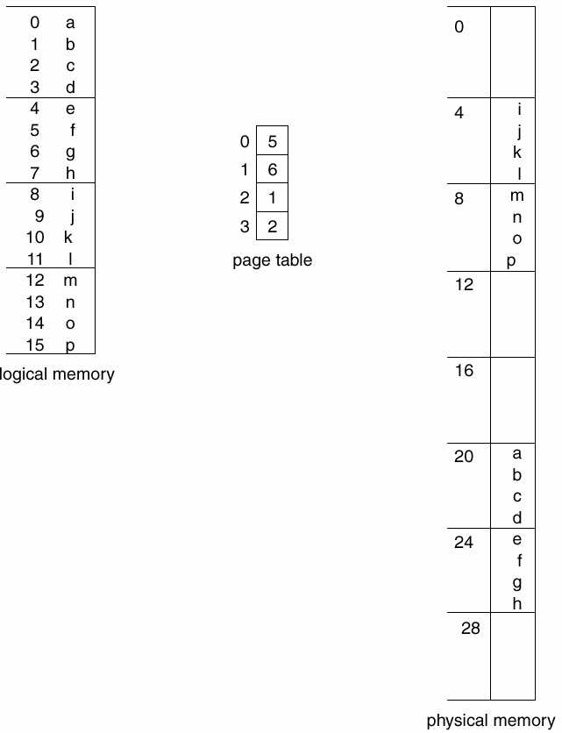
Paging Example
Page size = 4 bytes
Process address space
= 4 pages
Physical address space
= 8 frames
Logical address: (1,3)
= 0111
Physical address: (6,3)
= 11011
0
Page
Frame
1
0111
2
3
11011

Slide 14
Addressing in Paging
Logical address space of 16 pages of 1024 words each, mapped into a physical memory of 32 frames.
Logical address size?
Physical address size?
Number of bits for p, f, and d?

Slide 15
Addressing in Paging
No. of bits for p = 4 bits
No. of bits for f = 5 bits
No. of bits for d = 11 bits

Slide 16
Addressing in Paging
Logical address size
= |p| + |d|
= 4+11
= 15 bits
Physical address size
= |f| + |d|
= 5+11
= 16 bits

Slide 17
Page Table Size
Page table size = NP * PTES
where NP is the number of pages in the process address
space and PTES is the page table entry size (equal to |f| based on our discussion so far).
Page table size
= 16 * 5 bits
= 16 bytes

Slide 18
Another Example
Logical address = 32-bit
Process address space = 2³² B
= 4 GB
Main memory = RAM = 512 MB
Page size = 4K
Maximum pages in a process address space = 2³² / 4K
= 1M

Slide 19
Another Example
|d| = 12 bits
|p| = 32 – 12 = 20 bits
No. of frames
= 512 M / 4 K
= 128 K
|f| = 17 bits
Physical address = 17+12 bits

Slide 20
Page Table Entries in Page Table
Frame Number – It gives the frame number in which the current page you are looking for is present.
The number of bits required depends on the number of frames. Frame bit is also known as address translation bit.
Number of bits for frame = Size of physical memory/frame size
Other Optional bits
1.Present/Absent bit – Present or absent bit says whether a particular page you are looking for is present or absent. In case if it is not present, that is called Page Fault. It is set to 0 if the corresponding page is not in memory. Used to control page fault by the operating system to support virtual memory. Sometimes this bit is also known as valid/invalid bits.
Protection bit – Protection bit says that what kind of protection you want on that page. So, these bit for the protection of the page frame (read, write etc).
Referenced bit – Referenced bit will say whether this page has been referred in the last clock cycle or not. It is set to 1 by hardware when the page is accessed.

Slide 21
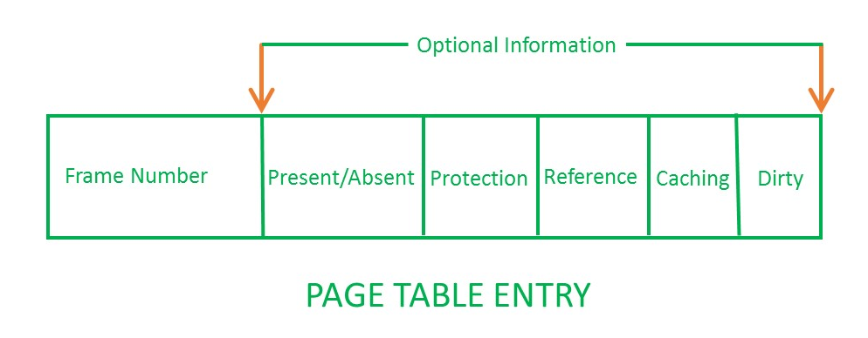
Page Table Entries in Page Table
Caching enabled/disabled – Some times we need the fresh data.
this bit enables or disable caching of the page.
Modified bit – Modified bit says whether the page has been modified or not. Modified means sometimes you might try to write something on to the page. If a page is modified, then whenever you should replace that page with some other page, then the modified information should be kept on the hard disk or it has to be written back or it has to be saved back. It is set to 1 by hardware on write-access to page which is used to avoid writing when swapped out. Sometimes this modified bit is also called as the Dirty bit.

Slide 22
Implementation of Page Table
Page table is kept in main memory
Page-table base register (PTBR) points to the page table
Page-table length register (PTLR) indicates size of the page table
In this scheme every data/instruction access requires two memory accesses
  One for the page table and one for the data / instruction
The two memory access problem can be solved
  by the use of a special fast-lookup hardware cache
  called associative memory or translation look-aside buffers
(TLBs)

Slide 23
Implementation of Page Table
Keep page table in the main memory
Page table base register (PTBR)
Teffective = 2Tmem
T_{effective} is not acceptable
Use a special, small, fast lookup hardware, called translation look-aside buffer (TLB)
Typically 64–1024 entries
An entry is (key, value)
Parallel search for key; on a hit, value is returned

Slide 24
Implementation of Page Table
(key,value) is (p,f) for paging
For a logical address, (p,d), TLB is searched for p. If an entry with a key p is found, we have a hit and f is used to form the physical address. Else, page table in the main memory is searched.

Slide 25
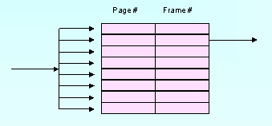
Logical address: (p, d)
TLB
f
p

Slide 26
Implementation of Page Table
The TLB is loaded with the (p,f) pair so that future references to p are found in the TLB, resulting in improved hit ratio.
On a context switch, the TLB is flushed and is loaded with values for the scheduled process.

Slide 27
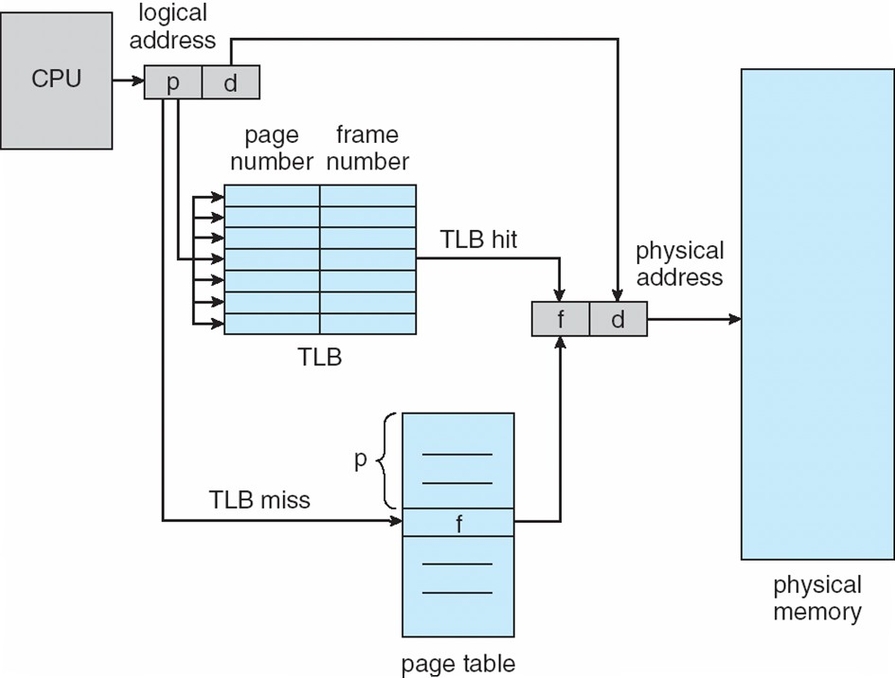
Paging Hardware With TLB

Slide 28
Performance of Paging
▪
▪
Teffective on a hit = Tmem + TTLB Teffective on a miss = 2Tmem + TTLB
If HR is hit ratio and MR is miss ratio, then
Teffective = HR (TTLB + Tmem) + MR (TTLB + 2Tmem)

Slide 29
Example
T_{mem} = 100 nsec
T_{TLB} = 20 nsec
Hit ratio is 80%
Teffective = ?
T_{effective} = 0.8 (20 + 100) + 0.2 (20 + 2x100)
= 140 nanoseconds

Slide 30
Example
T_{mem} = 100 nsec
T_{TLB} = 20 nsec
Hit ratio is 98%
Teffective = ?
T_{effective} = 0.98 (20 + 100) + 0.02 (20 + 2x100)
= 122 nanoseconds

Slide 31
Structure of the Page Table
Memory structures for paging can get huge using straight- forward methods
  Consider a 32-bit logical address space as on modern computers
  Page size of 4 KB (2¹²)
  Page table would have 1 million entries (2³² / 2¹²)
  If each entry is 4 bytes -> 4 MB of physical address space / memory for page table alone
    That amount of memory used to cost a lot
    Don’t want to allocate that contiguously in main memory
Hierarchical Paging
Hashed Page Tables
Inverted Page Tables

Slide 32
Hierarchical/ Multi-level Page Tables
Break up the logical address space into multiple page tables
A simple technique is a two-level page table
WHY WE NEED Multilevel paging:
The need for multilevel paging arises when-
The size of page table is greater than the frame size.
As a result, the page table cannot be stored in a single frame in main memory.
We then page the page table

Slide 33
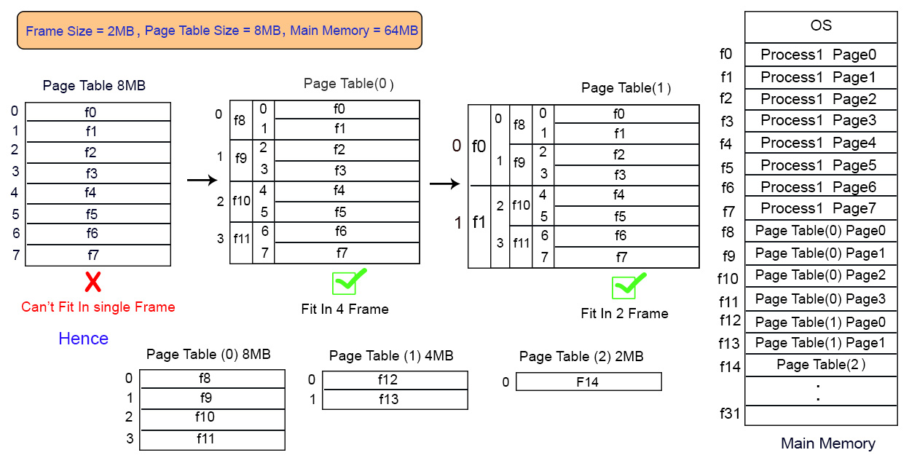
Multilevel Paging

Slide 34
EXAMPLE: 1
Illustration of Multilevel Paging-
Consider a system using paging scheme where-
Logical Address Space = 4 GB
Physical Address Space = 16 TB
Page size = 4 KB
Now, let us find how many levels of page table will be required.
Number of Bits in Physical Address-
Size of main memory
= Physical Address Space
= 16 TB
= 2⁴⁴ B
Thus, Number of bits in physical address = 44 bits
Number of Frames in Main Memory-
Number of frames in main memory
= Size of main memory / Frame size
= 16 TB / 4 KB
= 2³² frames
Thus, Number of bits in frame number = 32 bits

Slide 35
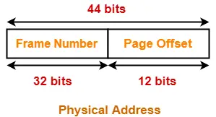
Number of Bits in Page Offset-
We have,
Page size
= 4 KB
= 2¹² B
Thus, Number of bits in page offset = 12 bits
So, Physical address is-
Alternatively,
Number of bits in page offset
= Number of bits in physical address – Number of bits in frame number
= 44 bits – 32 bits
= 12 bits

Slide 36
Inner Page Table Size-
Inner page table keeps track of the frames storing the pages of process.
Inner Page table size
= Number of entries in inner page table x Page table entry size
= Number of pages the process is divided x Number of bits in frame number
= 2²⁰ x 32 bits
= 2²⁰ x 4 bytes
= 4 MB
Number of Pages of Process-
Number of pages the process is divided
= Process size / Page size
= 4 GB / 4 KB
= 2²⁰ pages
Now, we can observe-
The size of inner page table is greater than the frame size (4 KB).
Thus, inner page table can not be stored in a single frame.
So, inner page table has to be divided into pages.

Slide 37
Number of Pages of Inner Page Table-
Number of pages the inner page table is divided
= Inner page table size / Page size
= 4 MB / 4 KB
= 2¹⁰ pages
Now, these 2¹⁰ pages of inner page table are stored in different frames of the main memory.
Number of Page Table Entries in One Page of Inner Page Table-
Number of page table entries in one page of inner page table
= Page size / Page table entry size
= Page size / Number of bits in frame number
= 4 KB / 32 bits
= 4 KB / 4 B
= 2¹⁰
Number of Bits Required to Search an Entry in One Page of Inner Page Table-
One page of inner page table contains 2¹⁰ entries.
Thus,
Number of bits required to search a particular entry in one page of inner page table = 10 bits

Slide 38
Outer Page Table Size-
Outer page table is required to keep track of the frames storing the pages of inner page table.
Outer Page table size
= Number of entries in outer page table x Page table entry size
= Number of pages the inner page table is divided x Number of bits in frame number
= 2¹⁰ x 32 bits
= 2¹⁰ x 4 bytes
= 4 KB
Now, we can observe-
The size of outer page table is same as frame size (4 KB).
Thus, outer page table can be stored in a single frame.
So, for given system, we will have two levels of page table.
Page Table Base Register (PTBR) will store the base address of the outer page table.
Number of Bits Required to Search an Entry in Outer Page Table-
Outer page table contains 2¹⁰ entries.
Thus,
Number of bits required to search a particular entry in outer page table = 10 bits

Slide 39
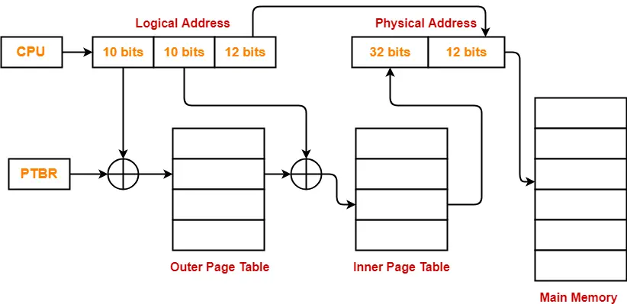
The paging system will look like as shown below:-

Slide 40
EXAMPLE: 2
Consider a system using multilevel paging scheme. The page size is 16 KB. The memory is byte addressable and virtual address is 48 bits long. The page table entry size is 4 bytes.
Find-
How many levels of page table will be required?
Give the divided physical address and virtual address.

Slide 41
Size of Main Memory-
Size of main memory
= Total number of frames x Frame size
= 2³² x 16 KB
= 2⁴⁶ B
= 64 TB
Thus, Number of bits in physical address = 46 bits
Number of Bits in Page Offset-
We have,
Page size
= 16 KB
= 2¹⁴ B
Thus, Number of bits in page offset = 14 bits
Alternatively,
Number of bits in page offset
= Number of bits in physical address – Number of bits in frame number
= 46 bits – 32 bits
= 14 bits
Solution-
Given-
Virtual Address = 48 bits
Page size = 16 KB
Page table entry size = 4 bytes
Number of Bits in Frame Number-
We have,
Page table entry size
= 4 bytes
= 32 bits
Thus, Number of bits in frame number = 32 bits
Number of Frames in Main Memory-
We have, Number of bits in frame number = 32 bits
Thus,
Number of frames in main memory
= 2³² frames

Slide 42
Process Size-
Number of bits in virtual address = 48 bits
Thus,
Process size
= 2⁴⁸ bytes
= 256 TB
Number of Pages of Process-
Number of pages the process is divided
= Process size / Page size
= 256 TB / 16 KB
= 2⁴⁸ B / 2¹⁴ B
= 2³⁴ pages
Inner Page Table Size-
Inner page table keeps track of the frames storing the pages of process.
Inner Page table size
= Number of entries in inner page table x Page table entry size
= Number of pages the process is divided x Page table entry size
= 2³⁴ x 4 bytes
= 2³⁶ bytes
= 64 GB
Now, we can observe-
The size of inner page table is greater than the frame size (4 KB).
64GB> 4KB
Thus, inner page table can not be stored in a single frame.
So, inner page table has to be divided into pages.

Slide 43
Number of Pages of Inner Page Table-
Number of pages the inner page table is divided
= Inner page table size / Page size
= 64 GB / 16 KB
= 2³⁶ B / 2¹⁴ B
= 2²² pages
Now, these 2²² pages of inner page table are stored in different frames of the main memory.
Number of Page Table Entries in One Page of Inner Page Table-
Number of page table entries in one page of inner page table
= Page size / Page table entry size
= 16 KB / 4 B
= 2¹² entries
Number of Bits Required to Search an Entry in One Page of Inner Page Table-
One page of inner page table contains 2¹² entries.
Thus,
Number of bits required to search a particular entry in one page of inner page table = 12 bits

Slide 44
Outer Page Table-1 Size-
Outer page table-1 is required to keep track of the frames storing the pages of inner page table.
Outer Page table-1 size
= Number of entries in outer page table-1 x Page table entry size
= Number of pages the inner page table is divided x Page table entry size
= 2²² x 4 bytes
= 16 MB
Now, we can observe-
The size of outer page table-1 is greater than the frame size (4 KB).
16MB >4KB
Thus, outer page table-1 can not be stored in a single frame.
So, outer page table-1 has to be divided into pages.

Slide 45
Number of Pages of Outer Page Table-1
Number of pages the outer page table-1 is divided
= Outer page table-1 size / Page size
= 16 MB / 16 KB
= 2¹⁰ pages
Now, these 2¹⁰ pages of outer page table-1 are stored in different frames of the main memory.
Number of Page Table Entries in One Page of Outer Page Table-1
Number of page table entries in one page of outer page table-1
= Page size / Page table entry size
= 16 KB / 4 B
= 2¹² entries
Number of Bits Required to Search an Entry in One Page of Outer Page Table-1
One page of outer page table-1 contains 2¹² entries.
Thus,
Number of bits required to search a particular entry in one page of outer page table-1 = 12 bits

Slide 46
Outer Page Table-2 Size-
Outer page table-2 is required to keep track of the frames storing the pages of outer page table-1.
Outer Page table-2 size
= Number of entries in outer page table-2 x Page table entry size
= Number of pages the outer page table-1 is divided x Page table entry size
= 2¹⁰ x 4 bytes
= 4 KB
Now, we can observe-
The size of outer page table-2 is less than the frame size (16 KB).
4KB< 16KB
Thus, outer page table-2 can be stored in a single frame.
In fact, outer page table-2 will not completely occupy one frame and some space will remain vacant.
So, for given system, we will have three levels of page table.
Page Table Base Register (PTBR) will store the base address of the outer page table-2.

Slide 47
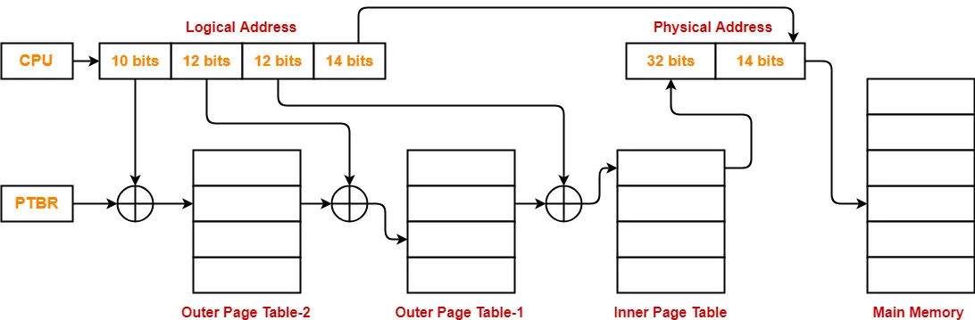
Number of Bits Required to Search an Entry in Outer Page Table-2
Outer page table-2 contains 2¹⁰ entries.
Thus,
Number of bits required to search a particular entry in outer page table-2 = 10 bits
The paging system will look like as shown below-

Slide 48
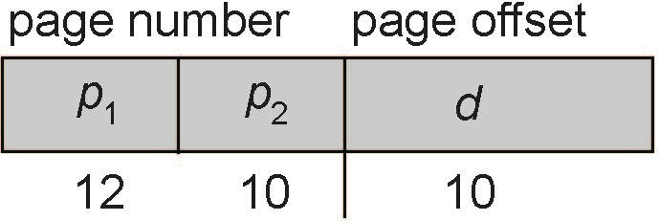
Two-Level Paging Example
A logical address (on 32-bit machine with 1K page size) is divided into:
  a page number consisting of 22 bits
  a page offset consisting of 10 bits
Since the page table is paged, the page number is further divided into:
  a 12-bit page number
  a 10-bit page offset
Thus, a logical address is as follows:
•
where p₁ is an index into the outer page table, and p₂ is the displacement within the page of the inner page table
Known as forward-mapped page table

Slide 49
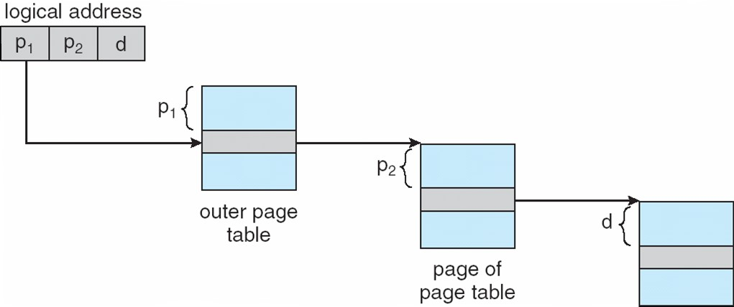
Address-Translation Scheme

Slide 50
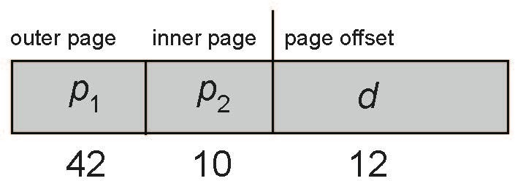
64-bit Logical Address Space
Even two-level paging scheme not sufficient
If page size is 4 KB (2¹²)
  Then page table has 2⁵² entries
  If two level scheme, inner page tables could be 2¹⁰ 4-byte entries
  Address would look like
Outer page table has 2⁴² entries or 2⁴⁴ bytes
One solution is to add a 2nd outer page table
But in the following example the 2nd outer page table is still 2³⁴ bytes in size
And possibly 4 memory access to get to one physical memory location

Slide 51
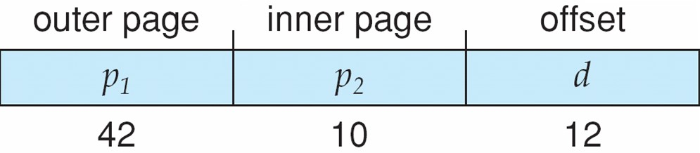
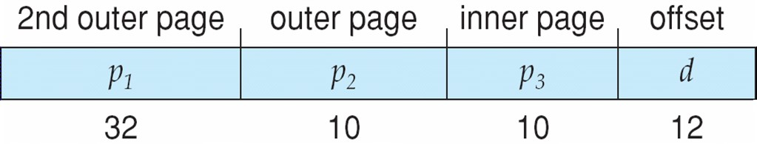
Three-level Paging Scheme

Slide 52
2- Hashed Page Tables
Common in address spaces > 32 bits
The virtual page number is hashed into a page table
  This page table contains a chain of elements hashing to the same location
Each element contains
  (1) the virtual page number
  (2) the value of the mapped page frame
  (3) a pointer to the next element
Virtual page numbers are compared in this chain searching for a match
  If a match is found, the corresponding physical frame is extracted
Variation for 64-bit addresses is clustered page tables
  Similar to hashed but each entry refers to several pages (such as 16) rather than 1
  Especially useful for sparse address spaces (where memory references are non-contiguous and scattered)

Slide 53
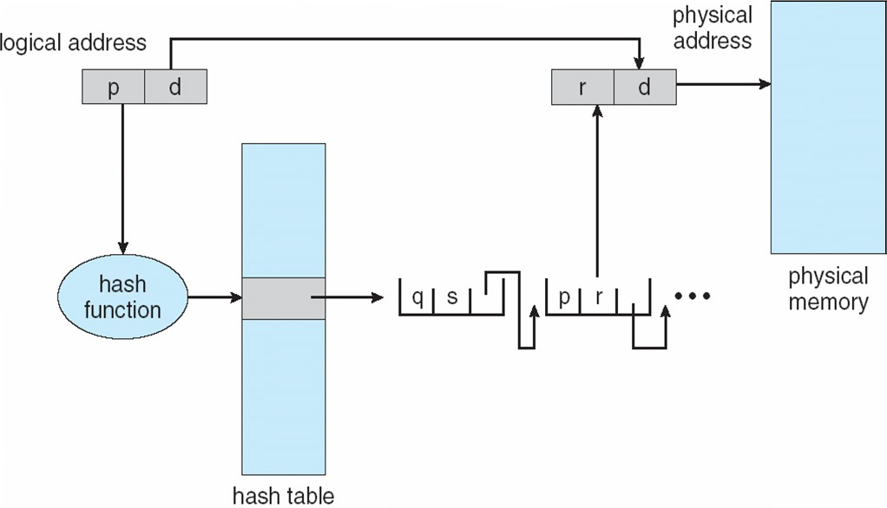
Hashed Page Table

Slide 54
3- Inverted Page Table
Rather than each process having a page table and keeping track of all possible logical pages,
  track all physical pages
One entry for each real page of memory
Entry consists of
  the virtual address of the page stored in that real memory location,
  information about the process that owns that page
Decreases memory needed to store each page table
  but increases time needed to search the table when a page reference occurs
Use hash table to limit the search to one/few page-table entries
  TLB can accelerate access
But how to implement shared memory?
  One mapping of a virtual address to the shared physical address

Slide 55
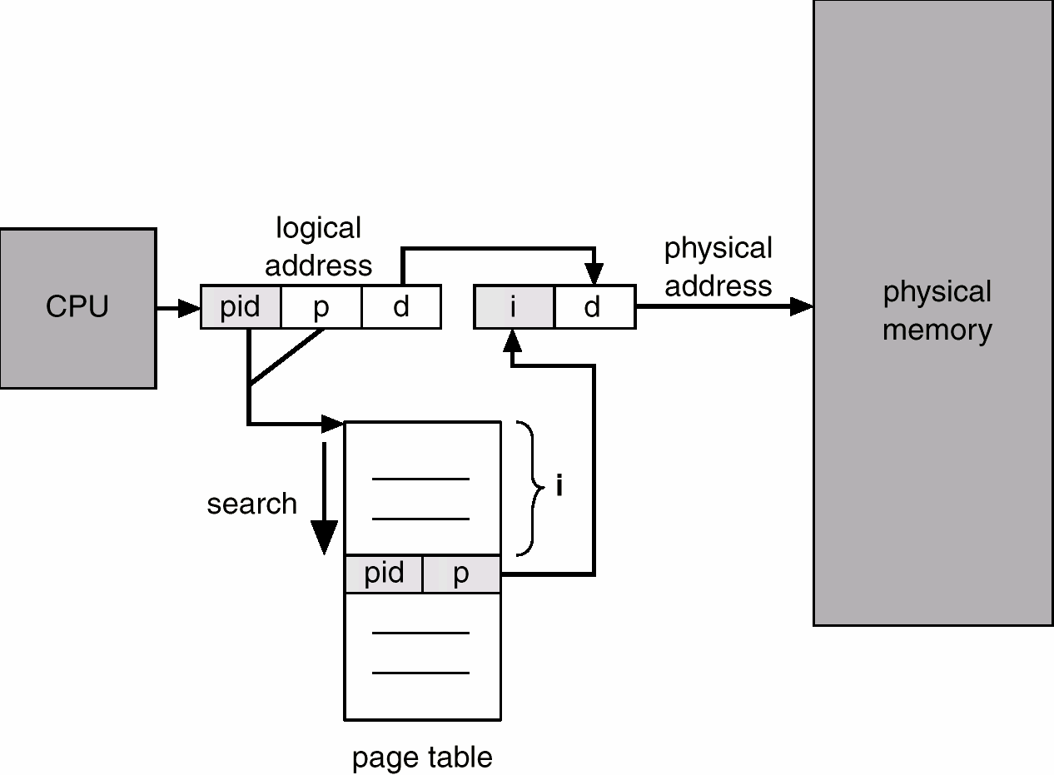
Inverted Page Table Architecture
Frame Number

Slide 56
Segmentation
A memory management scheme that supports programmer’s view of memory.
A segment is a logical unit such as: main program,
procedure, function, method, object, global variables,
stack, symbol table
A program is a collection of segments

Slide 57

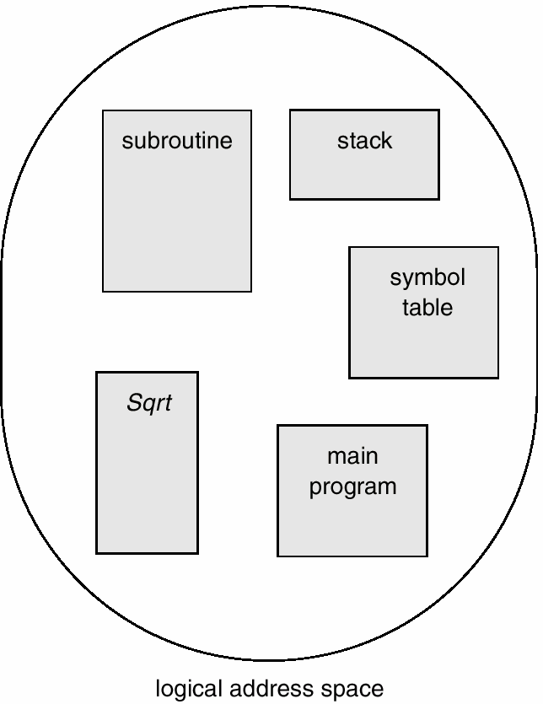
Segmentation

Slide 58

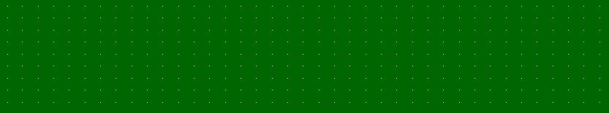
Segmentation
1
2
3
4
5

Slide 59



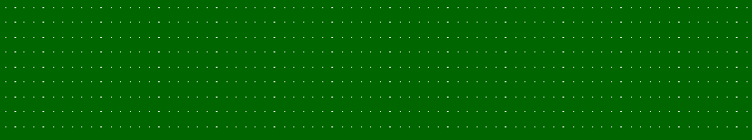
Segmentation
1
4
5
22
3
1
1
4
2
3
4
5
3

Slide 60



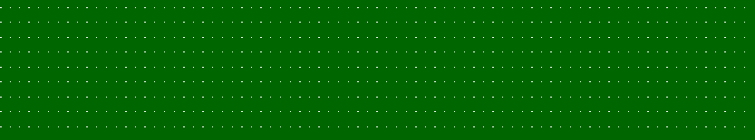
Segmentation
1
4
5
22
3
1
1
4
2
3
4
segment table
3
5

Slide 61
Segmentation
Logical address consists of a two tuple:
<segment-number, offset>
Segment table – maps two-dimensional logical addresses to physical addresses

Slide 62
Segmentation
Each segment table entry has:
  base – contains the starting physical address where the segments reside in memory.
  limit – specifies the length of the segment.

Slide 63
Segmentation
Segment-table base register (STBR) points to the segment table’s location in memory.
Segment-table length register (STLR) indicates number of segments used by a program
Segment number s is legal if s < STLR

Slide 64
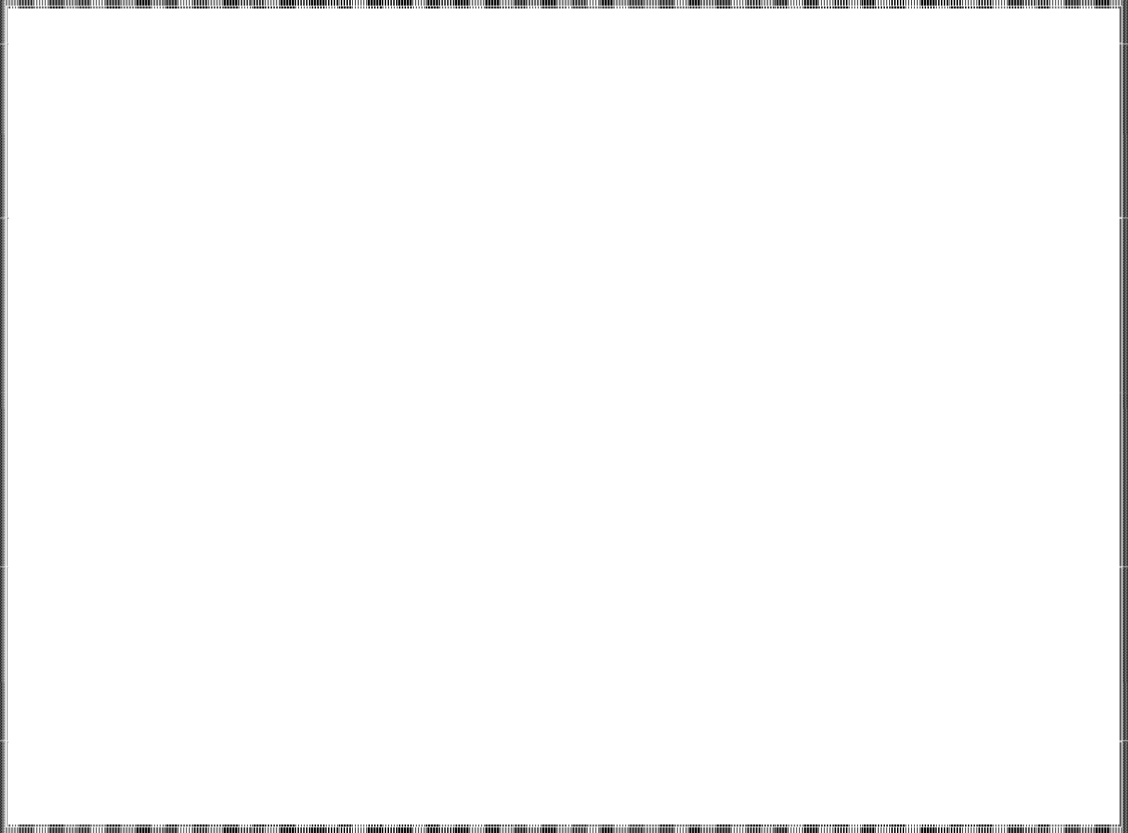
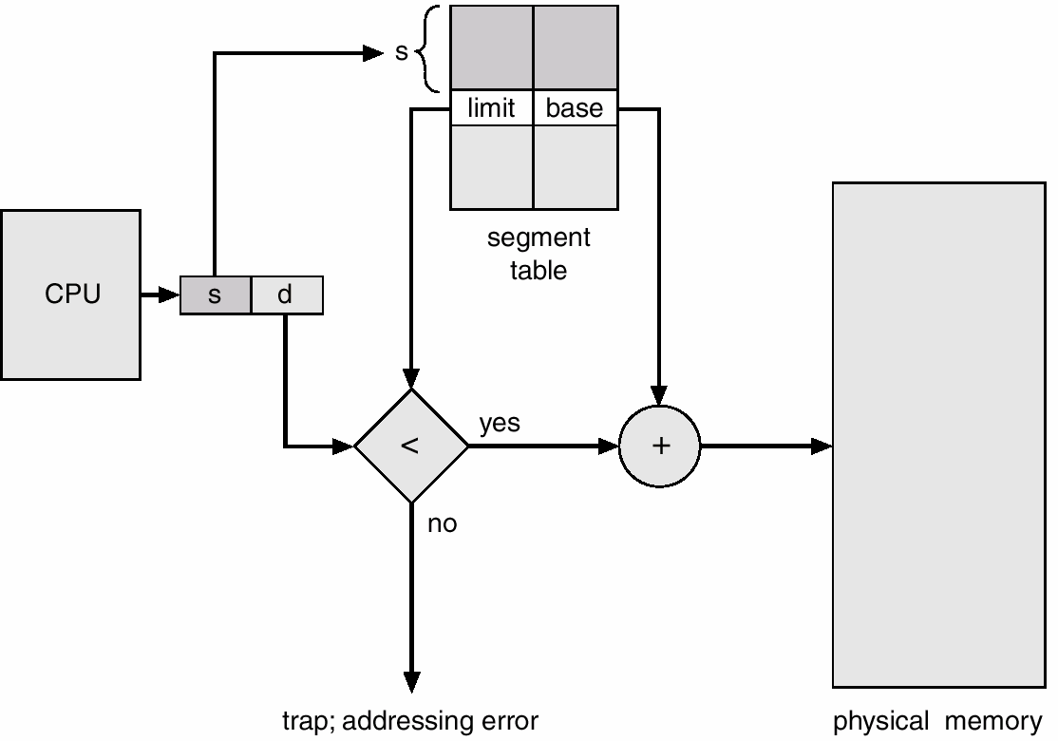
Segmentation
CPU

Slide 65
Segmentation Architecture
Dynamic Storage Allocation
  First fit
  Best fit
  Worst fit
  External fragmentation

Slide 66

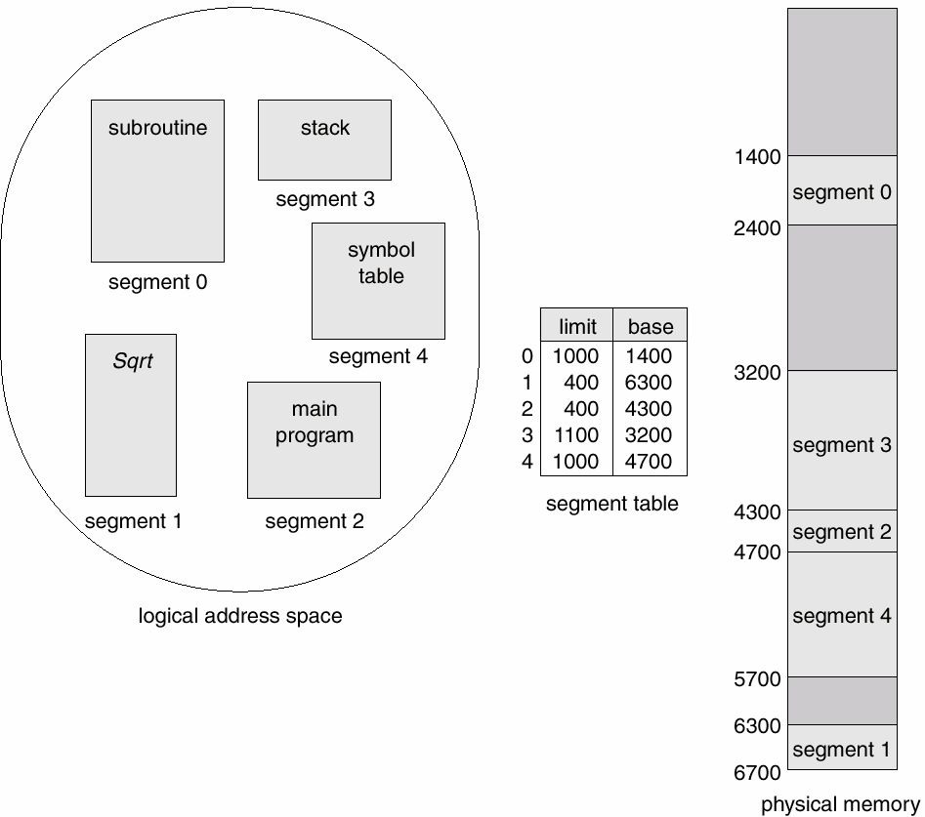
Example

Slide 67
Address Translation
Logical and Physical Addresses
  (2, 399) – PA: 4300+399 = 4699
(4, 0) – PA: 4700+0
(4, 1000) ⇒ trap
(3, 1300) ⇒ trap
= 4700
(6, 297) ⇒ trap

Slide 68
Issues with Segmentation
Reduce external fragmentation by compaction
  Shuffle segments to place free memory together in one block.
  Compaction is possible only if relocation is dynamic, and is done at execution time.

Slide 69
Issues with Segmentation
I/O problem
  Latch job in memory while it is involved in I/O.
  Do I/O only into OS buffers
Very large segments ⇒ page program segments—
paged segmentation

